Slide 1

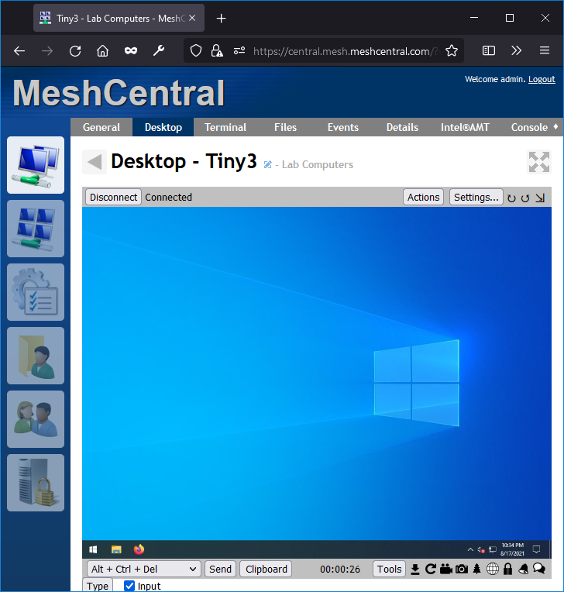


MeshCentral A
mesh.org.com
Agent
MeshCentral B

Slide 2


NeDB
MeshCentral A
Agent

